Slide 1

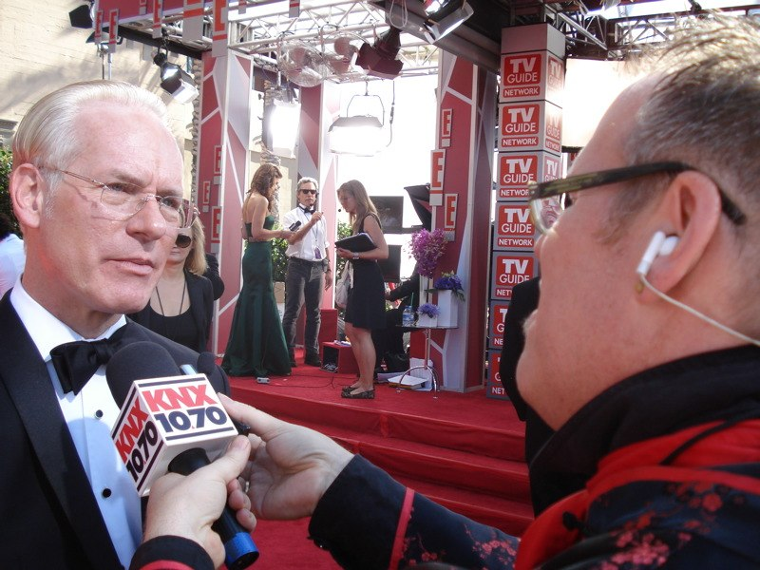
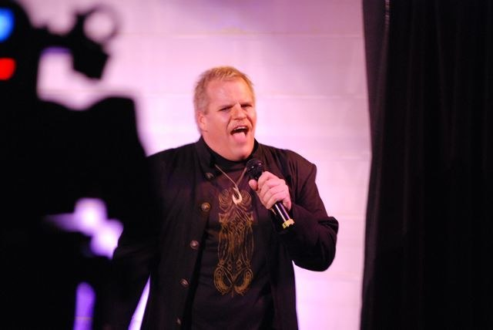
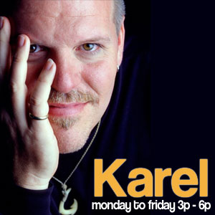
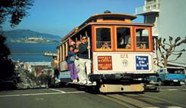
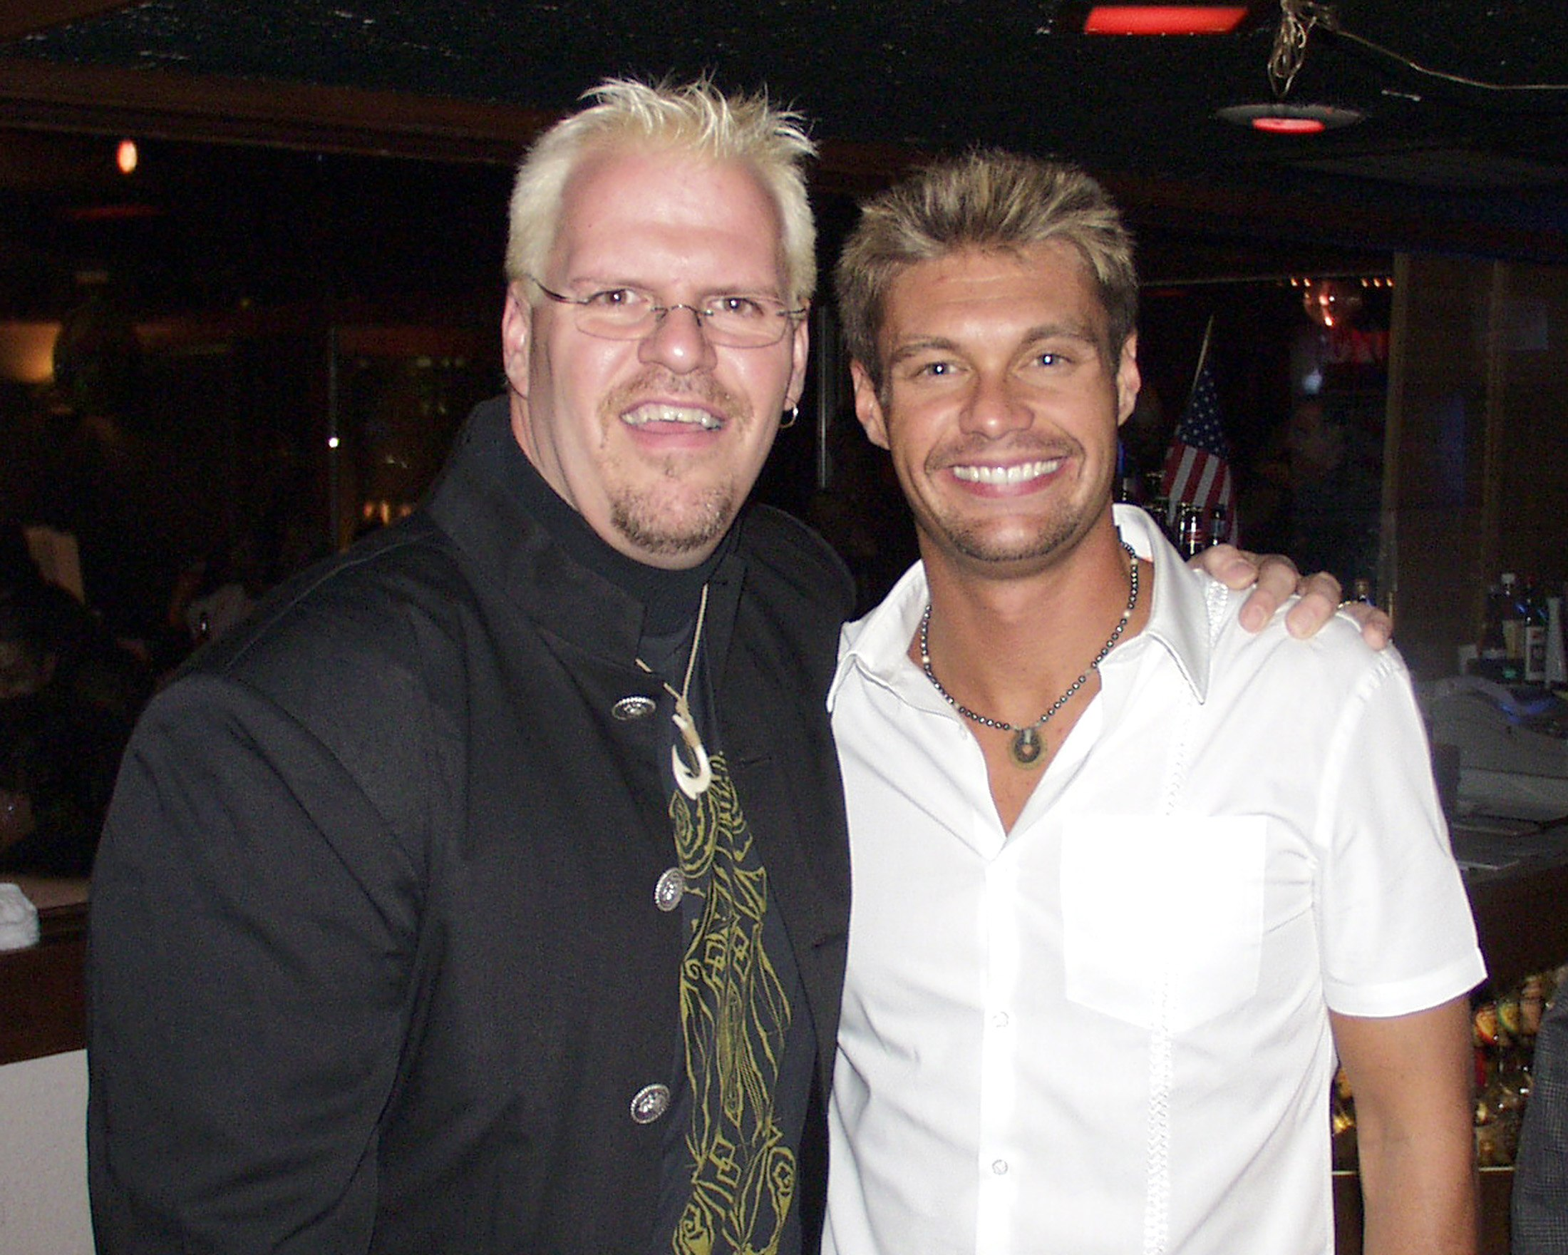
Common Sense from An Unexpected Source…
“THE KAREL SHOW”
…union is full of hosts, there’s only one of him!
œ
Contact
Charles R. Bouley II
business@thekarelshow.com
213-985-1962
Thekarelshow.com

Slide 2
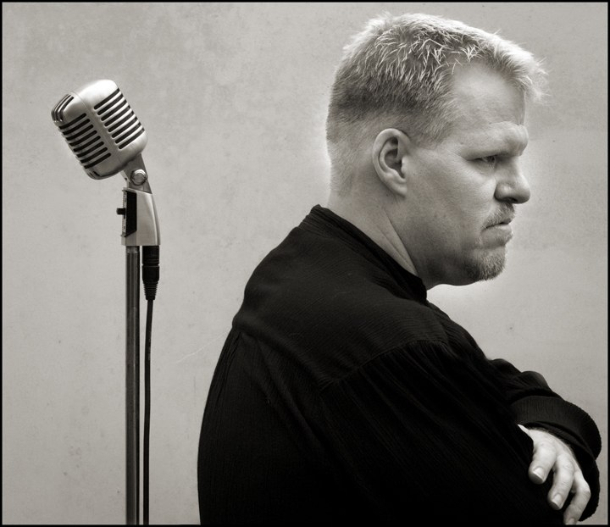
“THE KAREL SHOW”
Thekarelshow.com
History making host formerly of KFI AM 640 Los Angeles, KGO San Francisco and KNX 1070 now expanding in to syndication
National media visibility through TV as well as HuffingtonPost.com, Advocate.com and other outlets outside of radio
Informative, Entertaining and Relevant talk radio from a unique perspective with major market track record.
Top guest from politics, pop culture and all areas
Web community with passionate and committed Members including Android and Apple App, Podcast, Video Blog, Social Networking such as Twitter, Facebook
Fast Paced which means longer TSL (time spent listening)

Slide 3
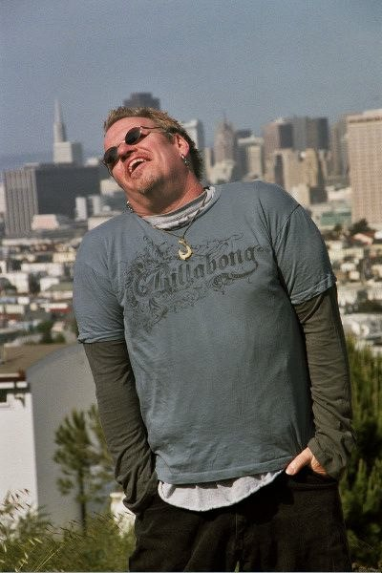
“THE KAREL SHOW”
Karel (Charles Karel Bouley) is a syndicated talk show host heard nationally (syndicated) as well as in the #4 Market in the Country, KGO San Francisco. He continues his #1 talk shows at Cumulus’ flagship station, KGO AM 810 San Francisco and made history for KFI AM 640 Los Angeles. Now, the Karel Show can be heard in various markets syndicated through GCN (Genesis Communications) as well as CRN (Digital Cable and Radio Network).
He's served as an entertainment reporter and film critic as well having worked for KNX 1070 Los Angeles (CBS). Karel also has filled for Bill Press on his national show on a regular basis. The show is available at iTunes as a free podcast, in the Karel App for both iOS and Android, through a daily Ustream show, online at GCN and CRN and on TVs across America!
He is a blogger for the HuffingtonPost.com and has been a columnist for the #1 gay/lesbian newsmagazine The Advocate atAdvocate.com and IN Magazine Los Angeles, as well as Billboard and others. His first book of essays "You Can't Say That" is published by Alyson Press and his second book, “Shouting at Windmills: BS from Bush to Obama” through Createspace (available now). His music is available at iTunes and other online stores and he maintains a blog, podcasts and message boards at www.thekarelshow.com and can be reached at business@thekarelshow.com
Karel also appears as a guest on topical issues having appeared on such cable news networks as CNN, MSNBC and Fox News. He was a regular guest on Techlink for Time/Warner, as a Macintosh Computer expert and even did two seasons as a lead actor on TNN's "Ultimate Revenge" hosted by Ryan Seacrest (an improved practical joke show a la Punk'd) created by industry veteran Woody Fraiser. Karel produced, directed and wrote a marriage equality PSA that won second place in GLAAD's "I Do" contest, being aired at OutFest and on national television.
Karel made history with his late partner (on and off air) Andrew Howard as the duo became the first openly gay male couple to host a major market talk show when they took over afternoon drive at KFI AM 640 Los Angeles (following Rush Limbaugh and Dr. Laura on the #1 talk station in the country). Upon Andrew's untimely death in 2001, Karel went solo and personally changed state law in California so he could pursue a wrongful death lawsuit on behalf of his partner. He does his shows from his studio at the home they shared, Park Howard, in Long Beach, CA, where he lives with his dogs and cat.

Slide 4
Listener Profile
% of
GENDER Station Cume
Persons 12+ 100.0% 150,900
Male 12+ 52.0% 78,468
Female 12+ 48.0% 72,432
% of
Financial Station Cume Index
Household Has:
CDs 20.2% 19,598 99
IRA 28.6% 27,728 102
Money Market 30.7% 29,705 130
In The Past 3 Months Used:
Gold Or Platinum Credit Cards 89.7% 86,875 108
In The Past Year Used:
Accountant Or Financial Planner 23.5% 2,744 142
TRAVEL
In The Past Year Domestic:
Took 3+ Air Round Trips 20.0% 19,369 149
In The Past Three Years Foreign:
Took 3+ Trips 17.3% 16,774 146
TECHNOLOGY
Household Owns:
Computer 86.4% 83,700 112
Cell Phone Service For Self 74.7% 72,405 97
DVD Player 75.6% 73,269 100
Digital Camera 58.5% 56,666 89
Digital Video Recorder (TiVo etc.) 44.4% 43,020 114
MP3 Player 37.5% 36,319 89
High Definition TV (HDTV) 33.9% 32,849 89
PDA (Personal Digital Assistant Device) 13.3% 12,923 83
% of
EDUCATION, INCOME Station Cume Index
College Graduate 18.2% 17,654 97
College Graduate Or More 42.9% 41,529 118
Annual Household Income, $100,000 43.3% 41,968 113
Annual Household Income, $150,000 19.8% 19,176 103
EMPLOYMENT
White Collar Occupation 50.4% 48,802 104
Management/Business/Financial 9.9% 9,575 111
Self-Employed 10.9% 10,601 100
HOME OWNERSHIP
Own Home 72.4% 70,095 116
Home Value Is $500,000+ 61.1% 59,205 129
Have 2nd Home/Real Estate Property 4.9% 4,734 81
AUTOMOTIVE
Own Any New Domestic Vehicle 13.1% 12,698 80
Own Any New Foreign Vehicle 16.1% 15,552 85
Plan To Buy A Hybrid Vehicle 6.2% 5,986 140
Sources: (Gender) Arbitral, Nov08 – Jan09 PPM, Mon-Sun 6am-12mid, Persons 12+, San Francisco Metro, Cume
(Qualitative) Scarborough, August 07 – July 08, Mon-Sun 6am-12mid, Adults 18+, San Francisco Metro, % Of Station, Cume, and Index

Slide 5
Listener Profile
About 72% of KKGN’s listeners have some college education or more. Almost half are college grads or more!
Almost three-fourths of KKGN’s listeners own a home, and close to two-thirds own a home valued at $500,000+.
KKGN reaches over 135,000 consumers every week!
About 60% of KKGN’s listeners are employed and the
majority are employed in
while collar jobs. About 25% work in professional or managerial occupations, and about 10% are self-employed.
Over 55% of KKGN’s listeners have an annual household income of $75,000+!
56% of KKGN’s listeners are men and 44% are women.
Source: August 2007 – July 2008 Scarborough,
San Francisco Metro, Adults 18+, M-Su 6am-12mid, Cume %,
Age And Men/Women: Aug08-Oct08, Arbitron, Cume Persons, 12+

Slide 6

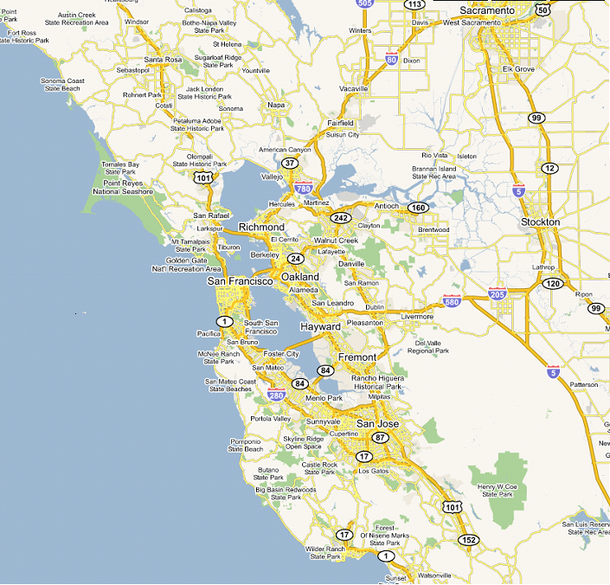
“THE KAREL SHOW”
Thousands of Active, Engaged, Progressive Listeners Each Week!
Female – 62% Male – 38%
72% of listeners are age 25-64
43.3% -- Household Income over $100,000
42.9% -- College graduate or more
72.4% -- Home ownership
2000 Website posts per week
150 listener calls per week

Slide 7
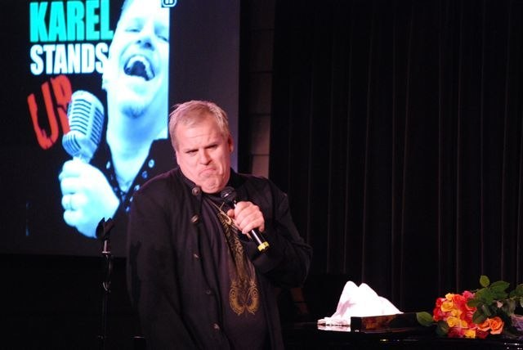
Partnering with “THE KAREL SHOW” Provides a Unique Opportunity
Multiple Market Radio Opportunity, Plus Web and beyond
Nationally recognized media figure behind your product
A live read by Karel boosts your place in the minds of a desired and varied audience
More editorial content than any other comparable program on commercial radio
Editorial vs. Ad Content ratio: 4 to 1
Drive time day part 3p-6pm PST.
Banner display adds reinforcement to the broadcast message
Karel’s unique personality and the unique editorial mix attracts a vibrant listener
that you want for a customer

Slide 8
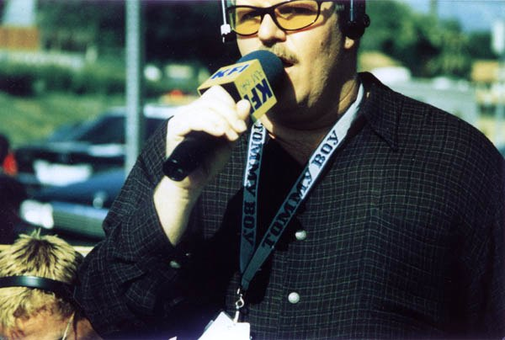
Why Radio Works
Selective - with RADIO you can target your message specifically
to people you want to reach.
Portable– RADIO goes any place, any time. You don’t have to set
aside time to listen. RADIO is a companion at home, at work, in your car.
Persuasive – RADIO helps you recruit new customers.
RADIO is direct and the message is instant.
Intrusive – RADIO bursts into your prospects minds whether
they have been thinking about you or not.
YOU will create business on RADIO!
Plus Terrestrial Radio is just part of the deal with the Karel Show. Podcast, live streams, video streams, blogs…Karel delivers in all media and formats, digital or traditional and carries your message with him!

Slide 9








Karel Show Sponsors
radios
Sun Run Solar

Slide 10
Building A
Partnership That Works
The Karel Show is heard on stations that boast a community of progressive political thinkers, with environmental sensibilities. Those stations also include nationally syndicated personalities Rachel Maddow, Stephanie Miller and Randi Rhodes. To listeners, The Karel Show fits seamlessly.
The Karel Show is a lifestyle brand that resonates with the passionately progressive and environmentally aware individuals that populate the various listening areas: Upscale consumers who care about the communities in which they live and have the discretionary income to make a difference with their purchasing power.
Whether its being the voice for change, educating listeners about the benefits of sustainability or simply having fun, The Karel Show is working to be the future of media.
The Karel brand transcends traditional radio and economic strata. Karel performs in all forms of entertainment, from stand up to television,
recording to acting .As the Karel brand expands and grows,
so does yours.

Slide 11
The Karel Show currently on on.
iTunes & Google Play KAREL Apps * Terrestrial * Online * Ustream * GCN and CRN Websites & Affiliates
The Karel Show
Sat 9pm to 12, Sun 7p to 10p
KGO NewsTalk 810 San Francisco
Mon-Fri 3pm to 6pm
Syndicated 3pm - 6pm PST (some stations time shift)
KRXA AM 540 Monterey/Salinas/Santa Cruz
KGOE Eureka
WVNJ New Jersey / New York
KJRB Spokane
KJFK Reno
WXMR 100.07 FM Vermont
Sun 5p to 7p
KJFK Reno, CRN-2
HuffingtonPost
http://www.huffingtonpost.com/charles-karel-bouley/
http://www.thekarelshow.com
http://listen.thekarelshow.com
http://media.thekarelshow.com
Karel Stands Up!
http://www.karelstandsup.com
Books at Amazon
http://tinyurl.com/

